Slide 1
CSIT558_01SP25 | ASSIGNMENT-3:
DESCRIPTIVE DATA MINING
BY
Chaudhari, Amishaben Natavarbhai [CWID:50129394]
Javed, Syed Mehrose [CWID: 50128848]
Subhani, Muhammad Kamal [CWID: 50136417]
Thangavel Sathiyamoorthy, Punithan [CWID: 50135877]
Venkata Appala Manoj Muvvala [CWID: 50122981 ]

Slide 2

DESCRIPTION
Dataset:
The ‘Spotify and Youtube’ dataset has been taken from Kaggle which contains data for the top 10 songs of different spotify artists and their youtube video. This dataset includes several statistics and attributes of the music version on spotify and the youtube video. E.g, Number of streams, Number of views, Loudness, Valence, Tempo, Danceability etc.
Goal:
The goal of our analysis is to identify how different attributes describe the popularity of songs and based on these attributes we want to cluster the songs into different categories of popularity which will help in identifying those attributes that affect a song’s popularity in a positive/negative way.

Slide 3
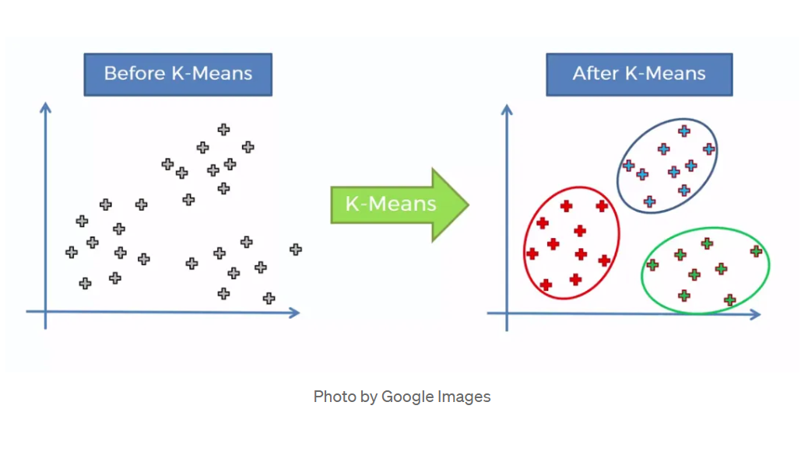
DESCRIPTIVE DATA MINING TECHNIQUE
K-Means Clustering:
K-means clustering is a popular method for grouping data by assigning observations to clusters based on proximity to the cluster’s center. It is an unsupervised machine learning technique that groups data points into predefined numbers of clusters based on similarity
Why K-Means?
Reduces number of attributes to few groups which aids in easier interpretation of the complex dataset.
Groups songs based on their attributes, and the metrics related to listener engagement that facilitates in uncovering patterns and relationships needed to understand listener behaviour.
Gives valuable quantitative insights into the central tendencies of different groups that helps to draw conclusions regarding the dataset.

Slide 4
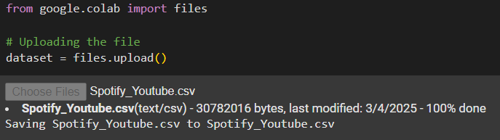
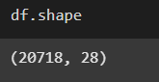
DATA LOADING
Loading the data
Loading the data for further processing (data preprocessing and algorithm execution) on the dataset.
Shape of the dataset
Attributes in the dataset
['Unnamed: 0', 'Artist', 'Url_spotify', 'Track', 'Album', 'Album_type', 'Uri', 'Danceability', 'Energy', 'Key', 'Loudness', 'Speechiness', 'Acousticness', 'Instrumentalness', 'Liveness', 'Valence', 'Tempo', 'Duration_ms', 'Url_youtube', 'Title', 'Channel', 'Views', 'Likes', 'Comments', 'Description', 'Licensed', 'official_video', 'Stream'] .

Slide 5
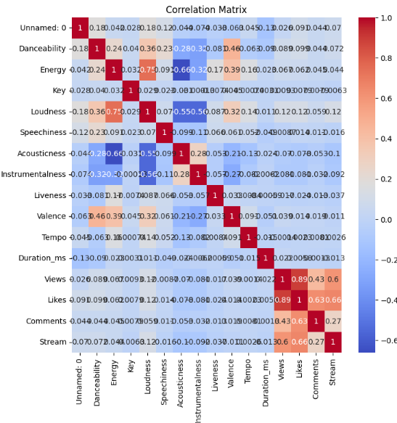
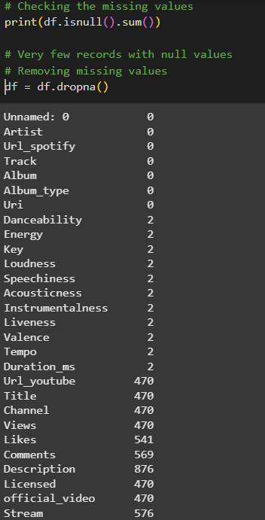
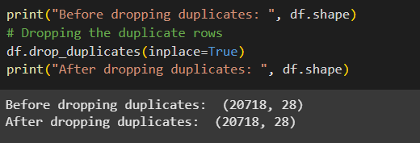
DATA PREPROCESSING
Null Check
Heat Map
Generating a heat map of the quantitative attributes to visualize their correlation with each other.
Duplicate Check

Slide 6
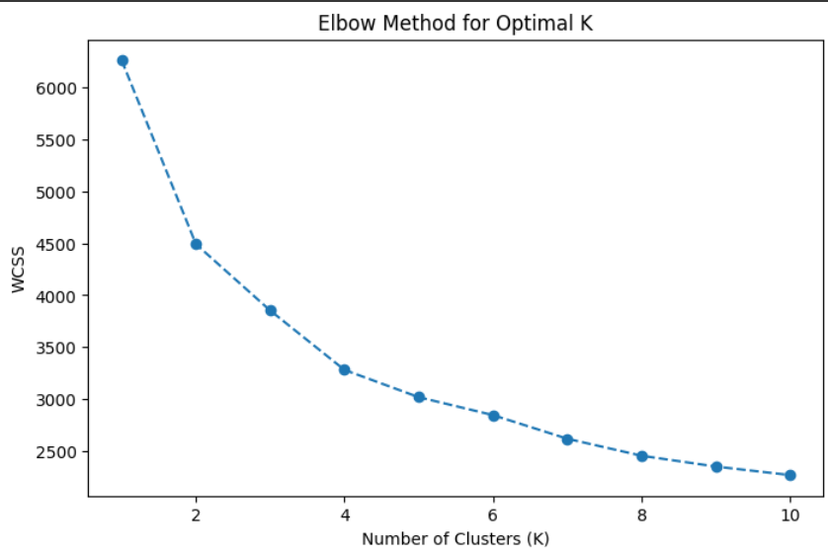
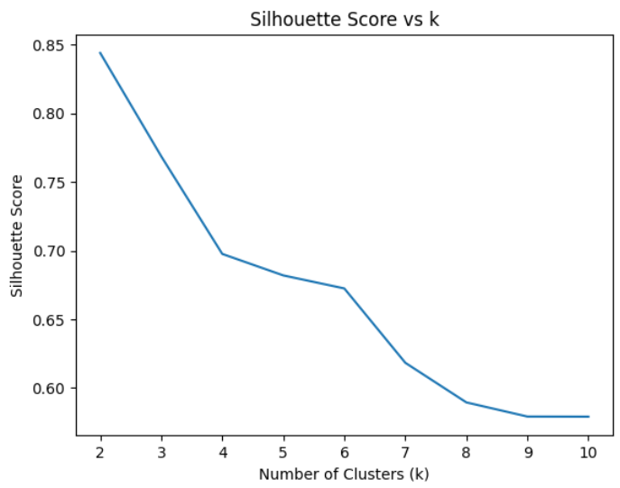
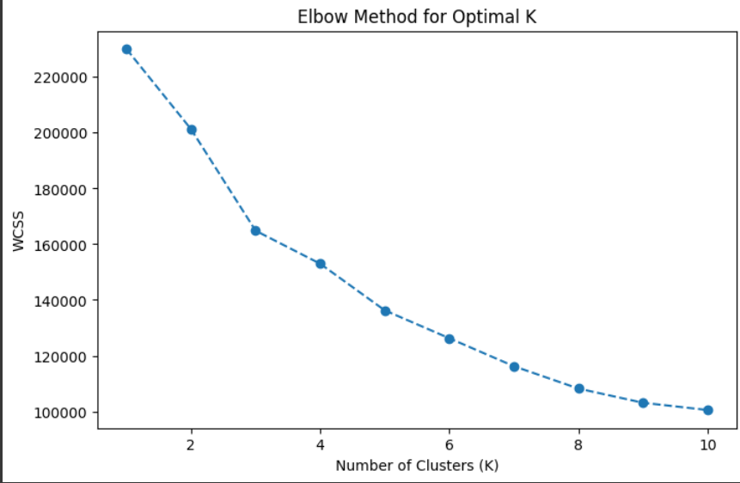
ALGORITHM EXECUTION
Determining the optimal value of k:
Silhouette Scores:
Elbow method:
MinmaxScaler
StandardScaler
Progressively decreasing values as k increases

Slide 7
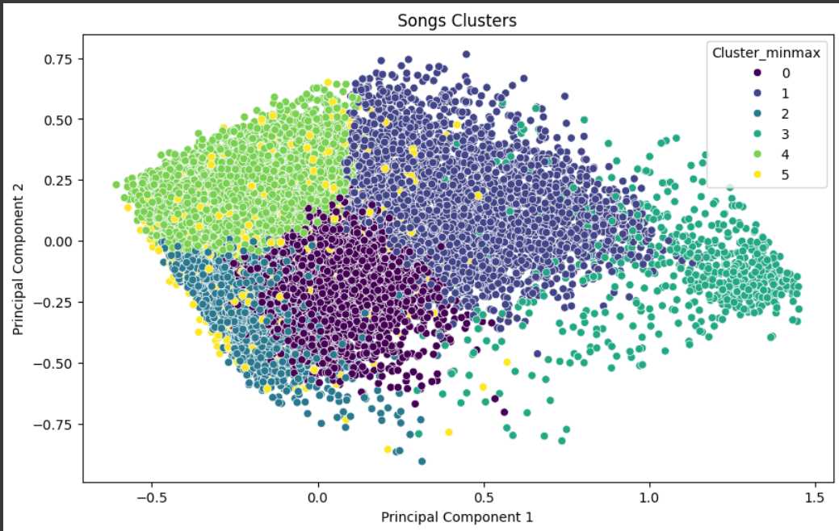
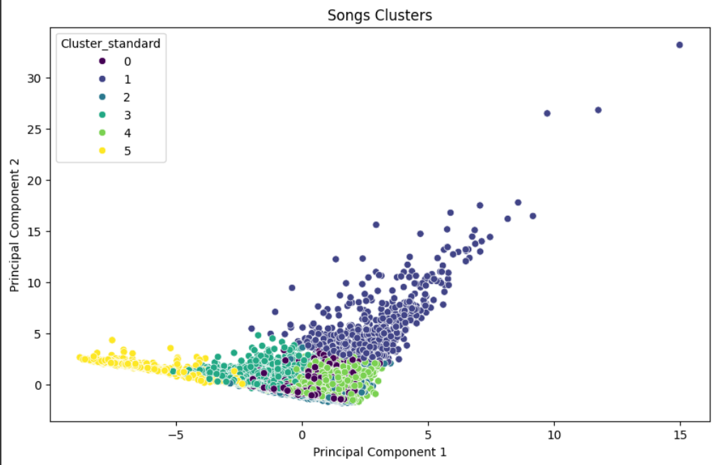
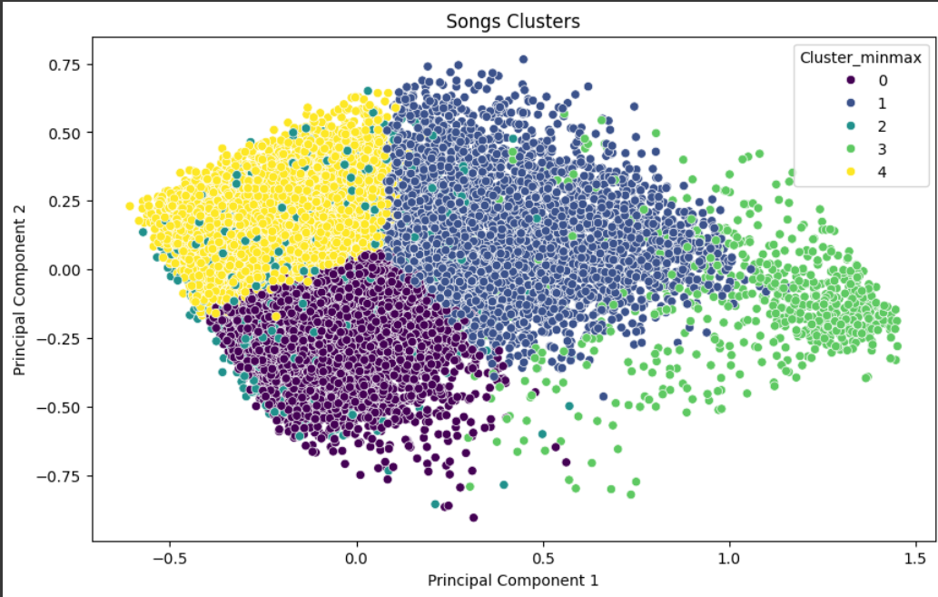
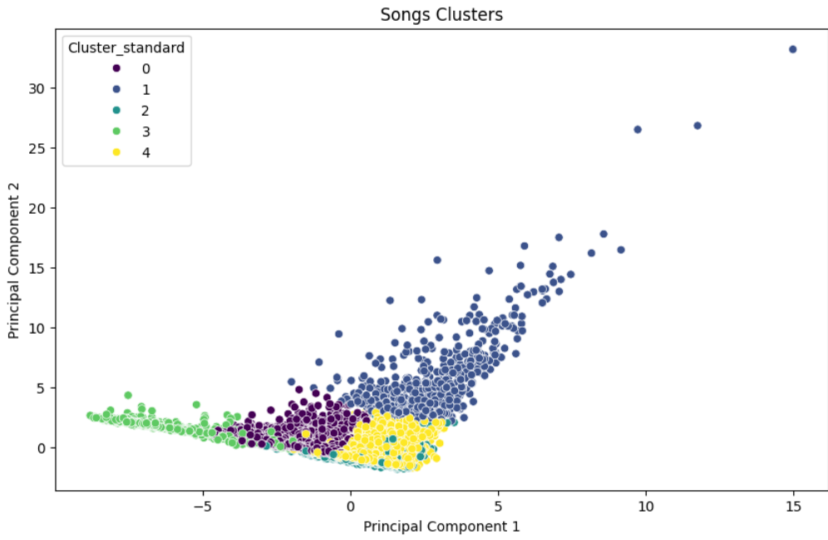
ALGORITHM EXECUTION
With higher values of k
Minmax;
k=6
StandardScaler;
k=6
Minmax;
k=5
StandardScaler;
k=5

Slide 8
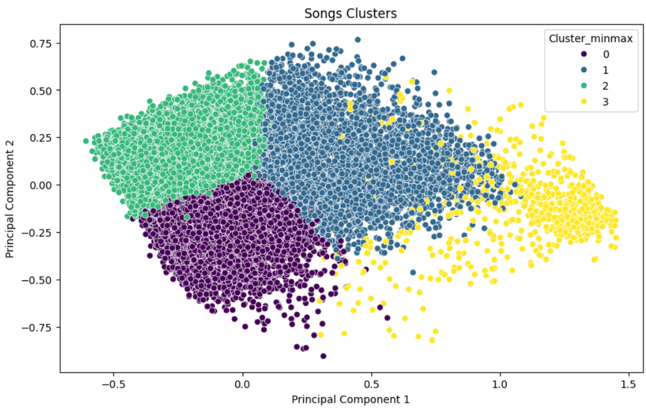
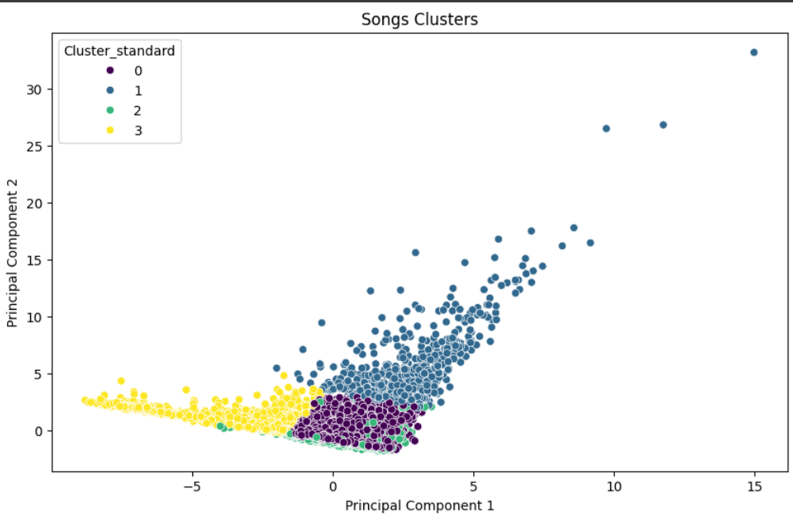
ALGORITHM EXECUTION
When k=4 and algorithm=’elkan’
MinmaxScaler StandardScaler

Slide 9
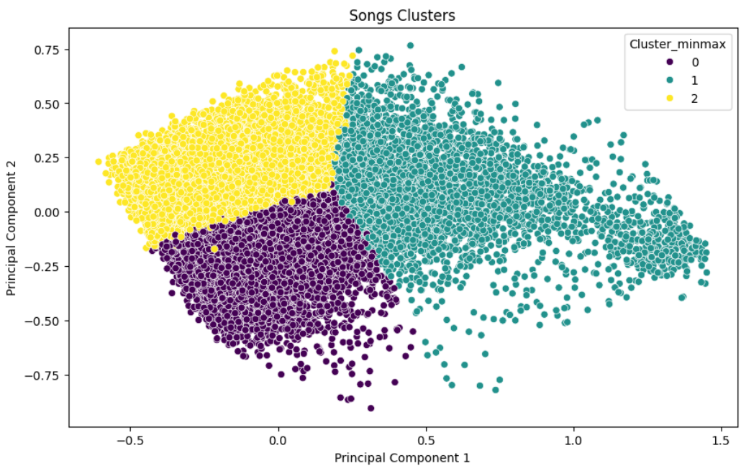
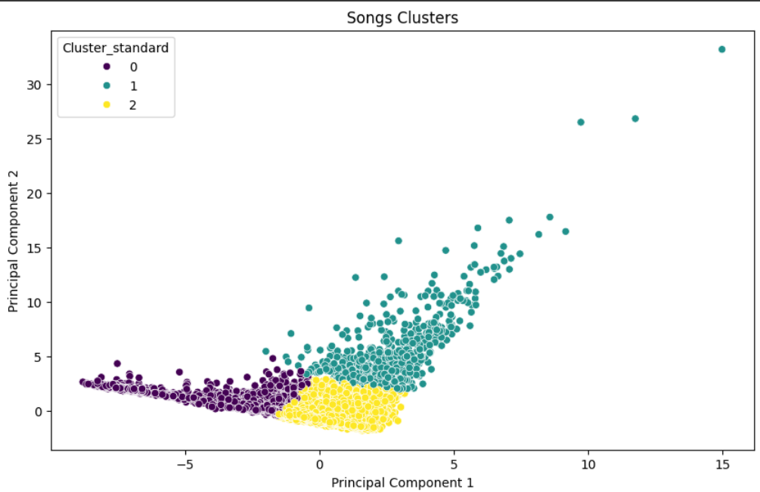
ALGORITHM EXECUTION
When k=3 and algorithm=’elkan’
MinmaxScaler StandardScaler

Slide 10

ALGORITHM EXECUTION
When k=4 and algorithm=’lloyd’
MinmaxScaler StandardScaler

Slide 11

ALGORITHM EXECUTION
When k=3 and algorithm=’lloyd’
MinmaxScaler StandardScaler

Slide 12
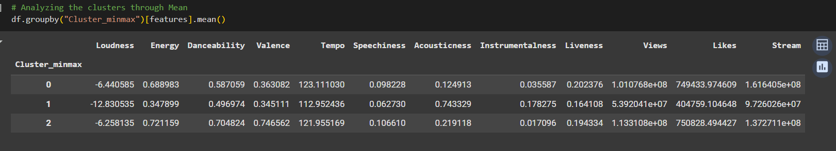
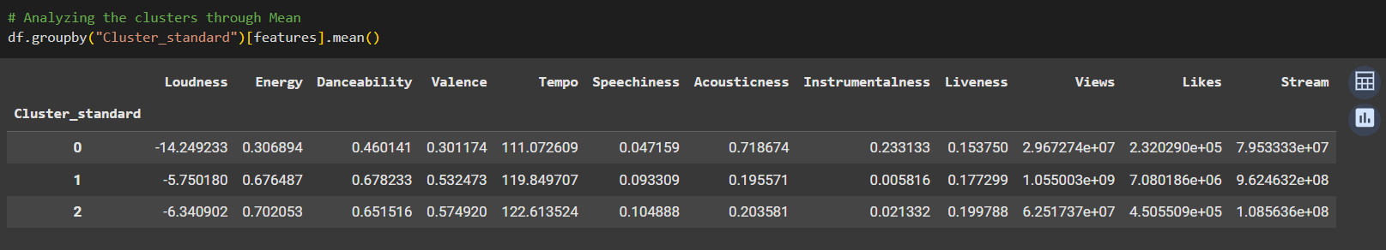
ALGORITHM EXECUTION : ANALYSIS
With 3 determined as optimal value for k, further analysis on the clusters using mean:
MinmaxScaler
StandardScaler

Slide 13
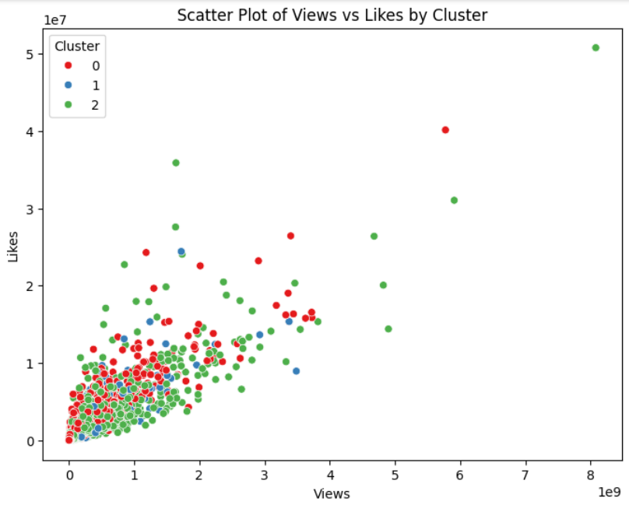
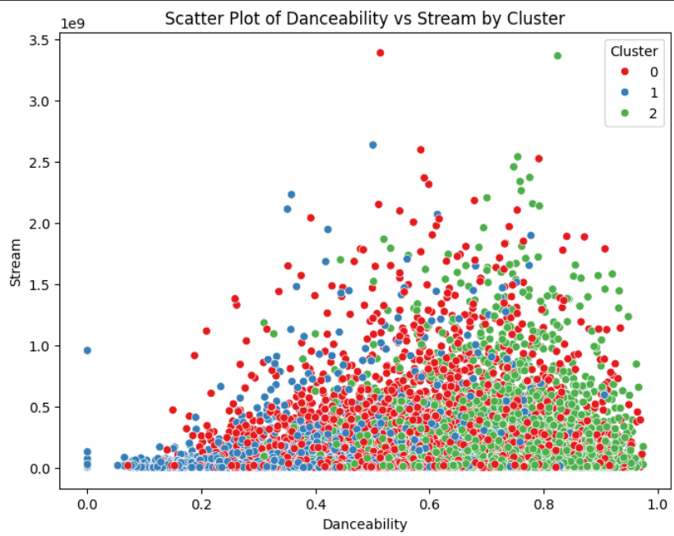
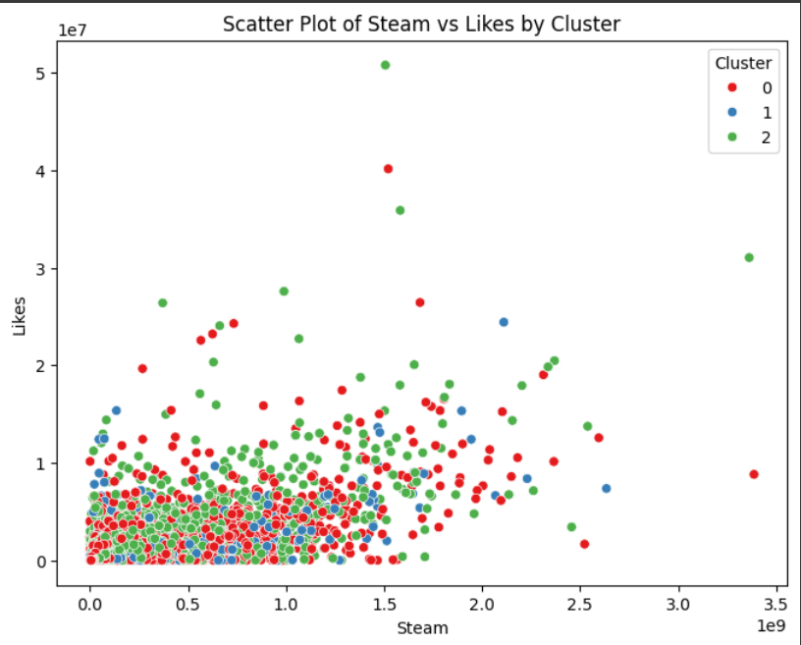
OBSERVATIONS
Examples of the rank of each cluster based on the mean value of attributes in MinmaxScaler of previous slide:
Views Rank | Likes Rank
Cluster 2 | Cluster 2
Cluster 0 | Cluster 0
Cluster 1 | Cluster 1
Danceability Rank | Stream Rank
Cluster 2 | Cluster 0
Cluster 0 | Cluster 2
Cluster 1 | Cluster 1
Stream Rank | Likes Rank
Cluster 0 | Cluster 2
Cluster 2 | Cluster 0
Cluster 1 | Cluster 1

Slide 14
CONCLUSIONS
The best value for number of clusters (k) is 3 where the clusters are correctly separated.
Based on the mean number of streams and song’s attributes:
Cluster 0 is the most popular with high energy, high danceability, less acoustic and less instrumental.
Cluster 1 is the least popular among the three with low energy and danceability, more acoustic and instrumental.
Cluster 2 is in the middle with medium energy and danceability, more liveness, valence and speechiness.
These data descriptions can help in describing a song with specified attributes which can further be used to do predictions based on these findings.
This can be used to categorize songs based on attributes and popularity.
This can also be used to recommend songs to users who listen songs based on different likeness of attributes.

Slide 15
REFERENCES
Dataset Source: https://www.kaggle.com/datasets/salvatorerastelli/spotify-and-youtube
Software Tools Used: a. Python, Pandas, NumPy, Scikit-learn, Matplotlib, Seaborn
b. Google Colab: For code execution
Online Sites Explored:
https://www.analyticsvidhya.com/blog/2019/08/comprehensive-guide-k-means-clustering/?utm_source=chatgpt.com
https://www.askpython.com/python/examples/plot-k-means-clusters-python?utm_source=chatgpt.com
4. Online Documentation & Resources:
Pandas: https://pandas.pydata.org/docs/
NumPy: https://numpy.org/doc/stable/

